Slide 1


ChatGPT and AI Tools
in Academia
Hrishikesh Yadav

Slide 2

TABLE OF CONTENTS
1
Understanding LLMs
2
How Does it work
3
Why Generative AI Now
4
Various Academia Task with AI
5
ChatGPT for task (MCQs, Assignments)
6
Classpoint Tool
7
Research Assistance - Working on Own Data

Slide 3
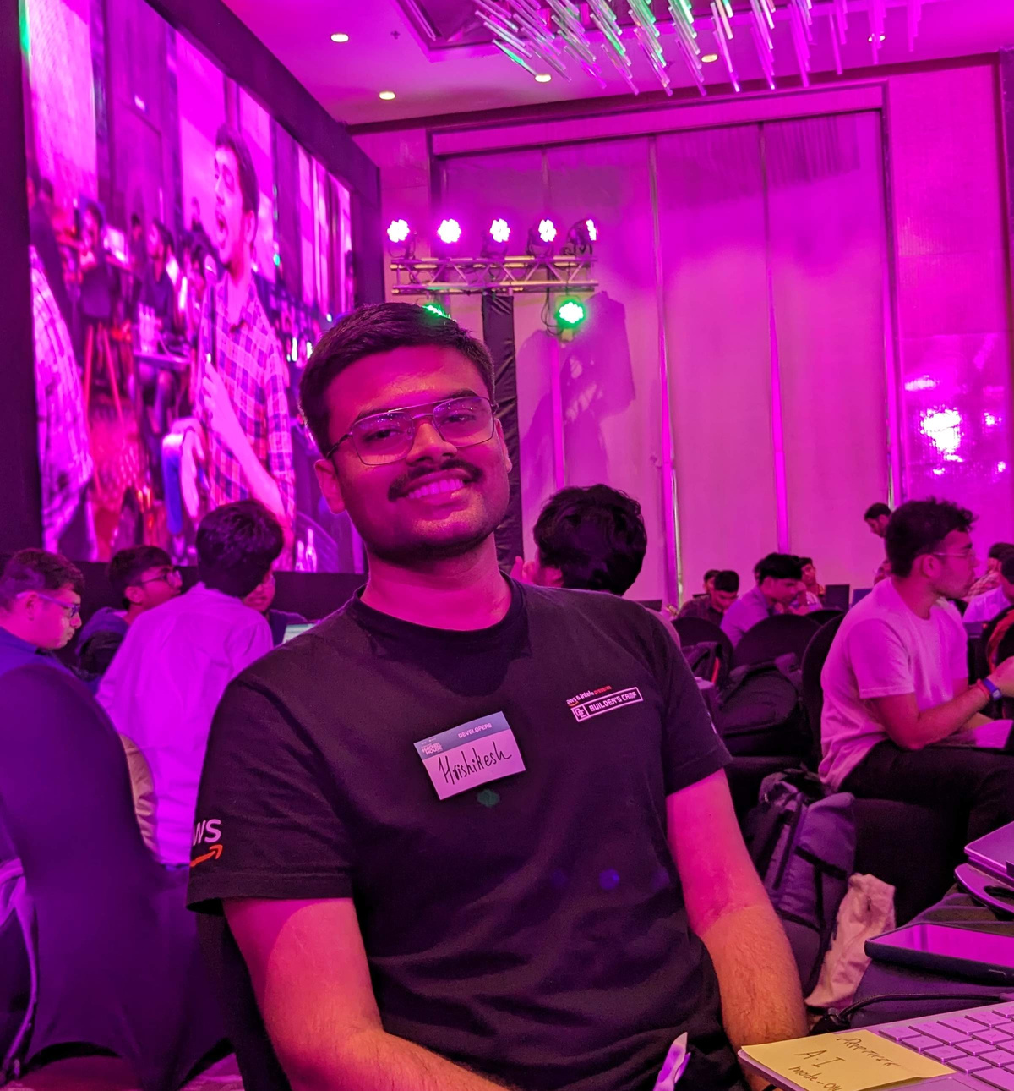
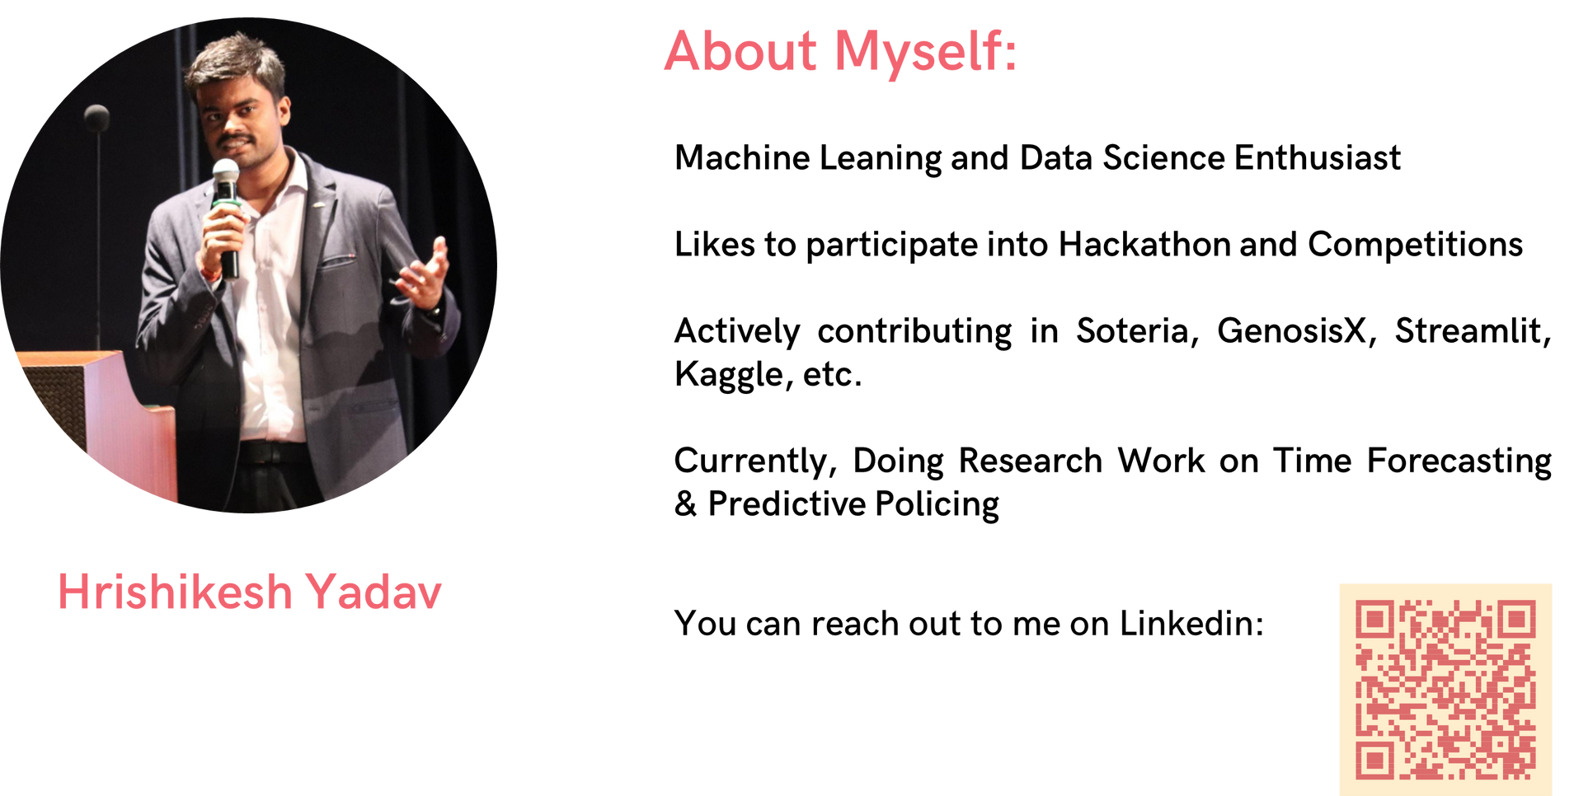

ABOUT
Machine Leaning, Data Science and Applied Generative AI Enthusiast
Likes to participate into Hackathon and Competitions
Actively contributing in Soteria, GenosisX, Streamlit, Kaggle, etc.
Currently, Doing Research Work on Predictive Policing and Applied Generative AI
GDSC TCET VCP 22-23
AI Lead @TCET OpenSource
Community Co-Lead @GenosisX
AI Instructor @RanchoLabs
Student Ambassador @Strealmit

Slide 4

KERAS API PHILOSPHY
Progressive Disclosure of Complexity

Slide 5
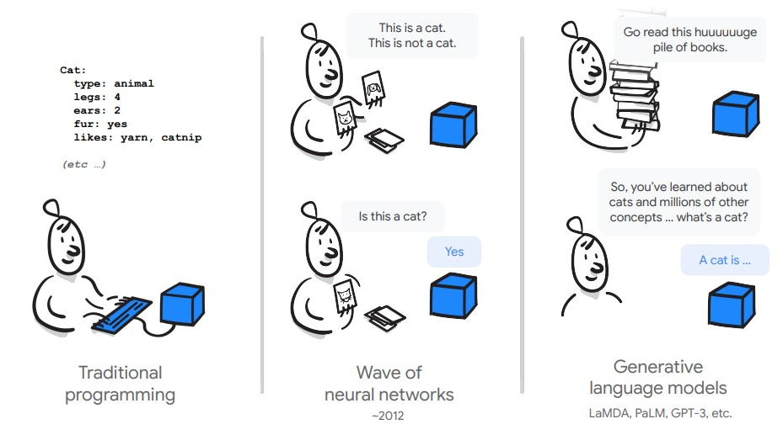
WHAT IS
LLM

Slide 6
WHAT IS
LLM
LLMs are typically trained on datasets large enough to include nearly everything that has been written on the internet.
LLMs can apply their language understanding to tasks they were never explicitly trained.
LLMs are not just for teaching AIs human languages, but for understanding proteins, writing software code, and much more

Slide 7
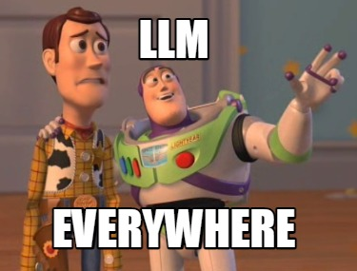
WHY LLM IS ON BOOM
Changes how we interact with the data
Can find pattern and connections in massive, disparate data corpus

Slide 8
WHY LLM IS ON BOOM
Does not need ML expertise
Does not need to train a model
Need zero training data
Only think about the prompt design

Slide 9
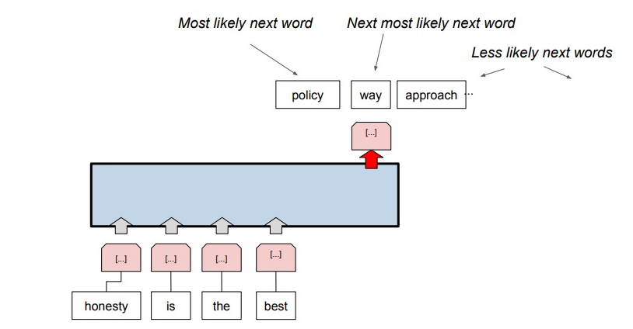
HOW DOES IT WORK

Slide 10
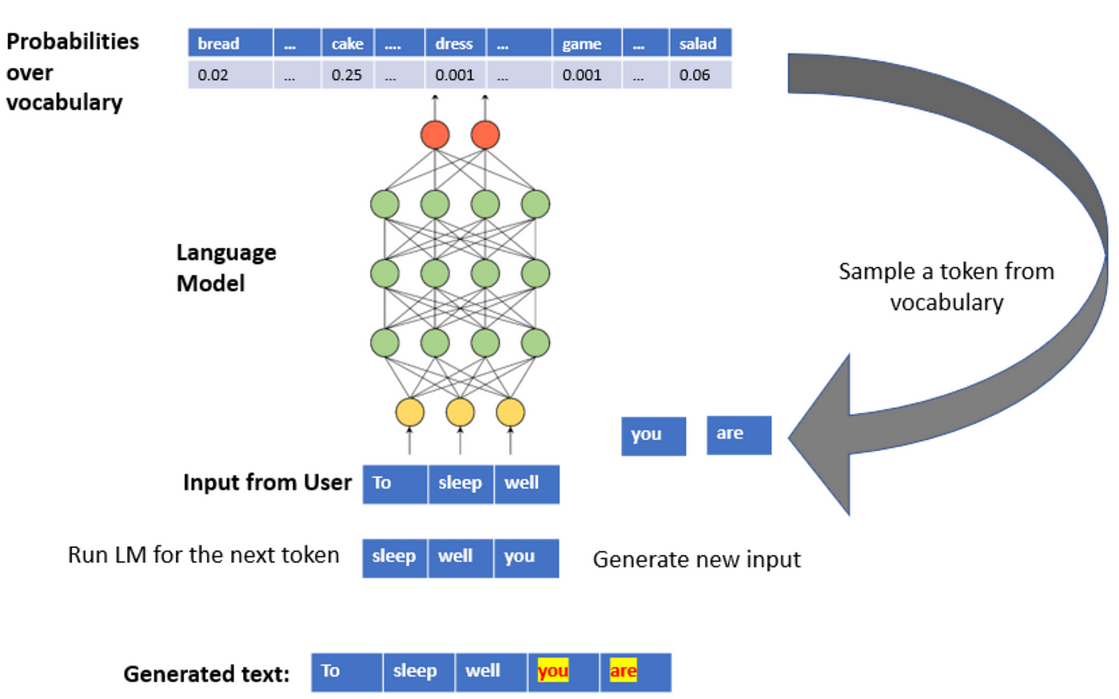
HOW DOES IT WORK
JAYESH

Slide 11
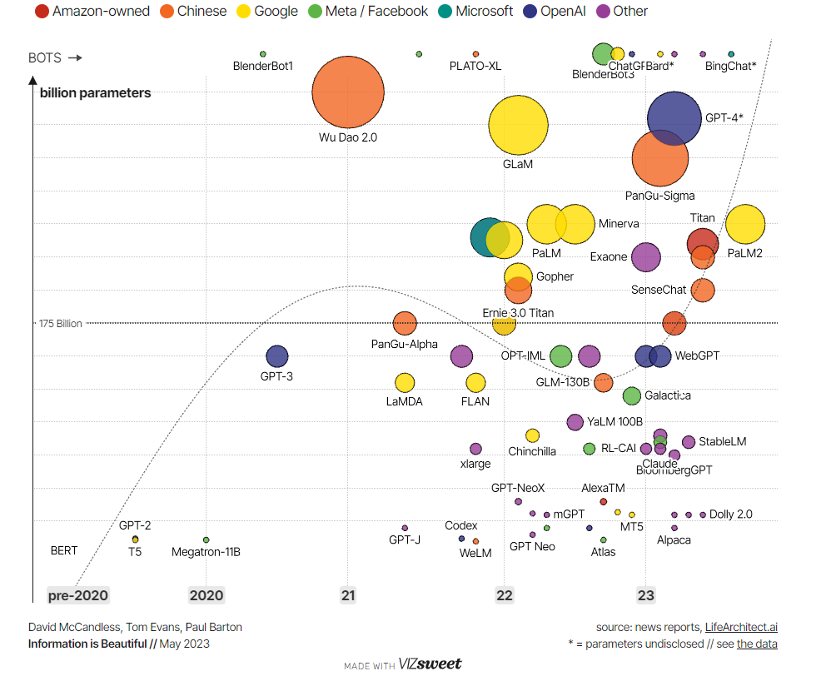
JOURNEY OF
LARGE
LANGUAGE
MODELS

Slide 12
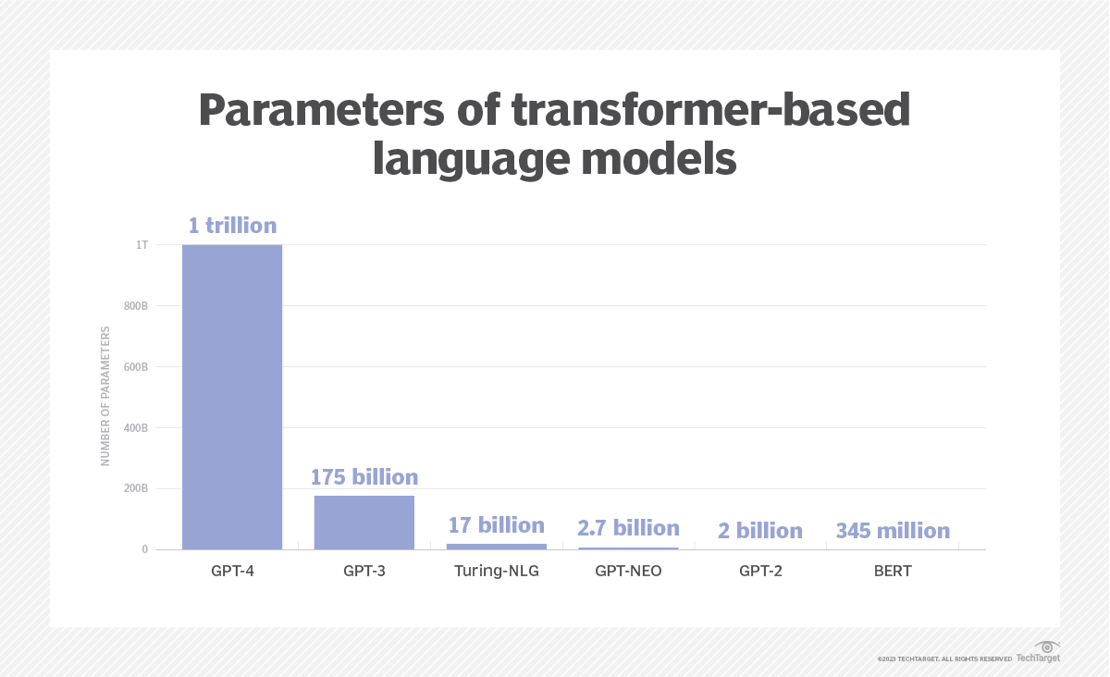

Slide 13




GENERATIVE AI FRAMEWORK

Slide 14
PROMPT ENGINEERING
Prompt - Text which is provided to the model
Prompt Design - The art of designing the prompt to get the reply which is the desired output

Slide 15
PROMPT ENGINEERING
Input - The sky is full of
Output - [stars(0.6), clouds (0.2), planes(0.002), ...]

Slide 16
PROMPT ENGINEERING
Input - The sky is full of
Output - [stars(0.6), clouds (0.2), planes(0.002), ...]

Slide 17
APPLICATION IN INDUSTRY
Customer Support
Generating product descriptions
Generating Code Snippets from prompt
Entity Extraction from KYC documents
HealthCare Domain Specific Task - Documentation

Slide 18
APPLICATION IN INDUSTRY
Customer Support
Generating product descriptions
Generating Code Snippets from prompt
Entity Extraction from KYC documents
HealthCare Domain Specific Task - Documentation

Slide 19
APPLICATION IN INDUSTRY
Customer Support
Generating product descriptions
Generating Code Snippets from prompt
Entity Extraction from KYC documents
HealthCare Domain Specific Task - Documentation

Slide 20
APPLICATION IN ACADEMIA
Creating lecture materials and outlines
Generating example problems and solutions
Preparing the Quizzes and Assignments
Generating talking points and outlines for lectures and presentations
Creation of PPT with Prompt

Slide 21
APPLICATION IN ACADEMIA
Literature review and summarization
Preparation of Question Paper
To Design the Workload Scheduler
Personal Task - Documentation, Mailing, etc.
Test Planning

Slide 22

HANDS-ON WITH CHATGPT

Slide 23
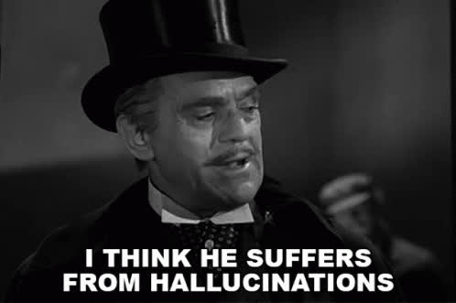
RAG
Domain Specific
Production Usage
Privacy
Stop Hallucination
Reduce unwanted information
Greater Control
Increase Consistency

Slide 24


RESOURCES AND
URL
Scan the QR

Slide 25
ABOUT
Machine Leaning, Data Science and Applied Generative AI Enthusiast
Likes to participate into Hackathon and Competitions
Actively contributing in Soteria, GenosisX, Streamlit, Kaggle, etc.
Currently, Doing Research Work on Predictive Policing and Applied Generative AI
GDSC TCET VCP 22-23
AI Lead @TCET OpenSource
Community Co-Lead @GenosisX
AI Instructor @RanchoLabs
Student Ambassador @Strealmit

Slide 26
